Slide 1
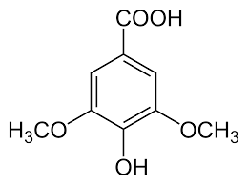

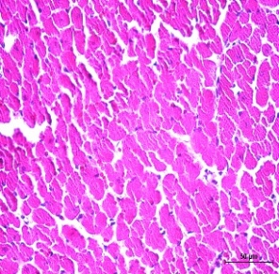
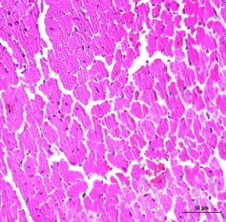
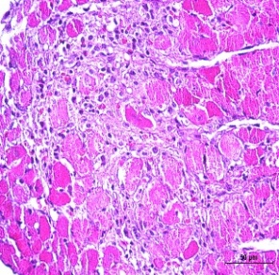
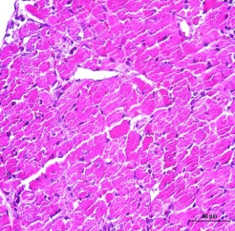
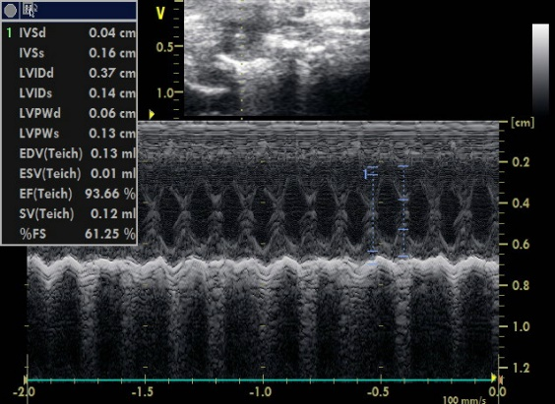
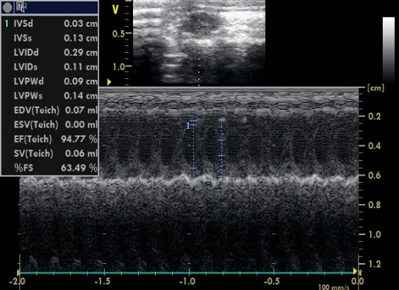
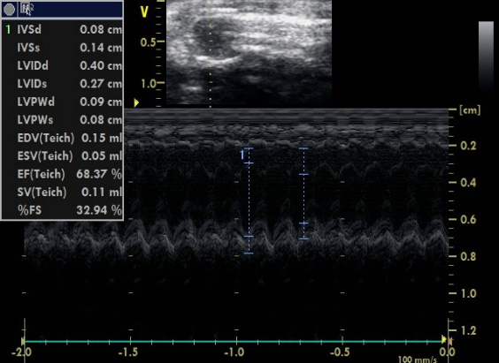
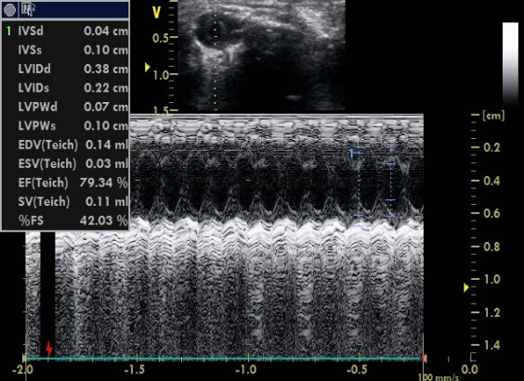
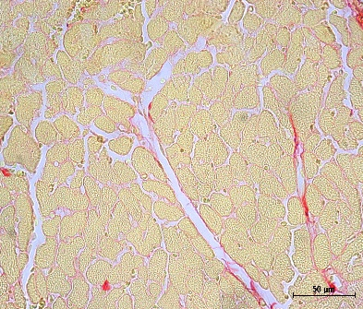
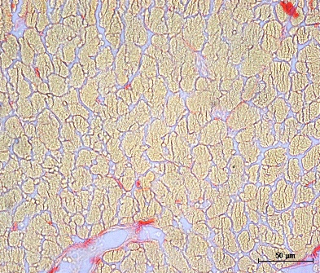
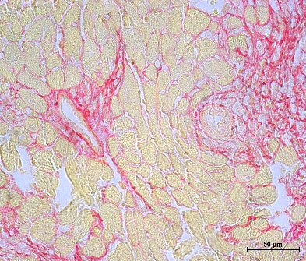
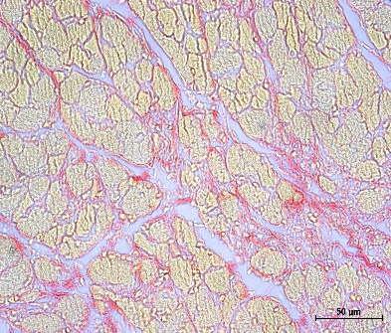
Syringic acid attenuates heart failure by
downregulating Acox2
Hae Jin Kee^{1,2}, Xiongyi Han^{1,2}, Liyan Bai^{1,2}, and Myung Ho Jeong^{1,2,3}*
1Heart Research Center of Chonnam National University Hospital, Gwangju, 61469, Republic of Korea
2Hypertension Heart Failure Research Center, Chonnam National University Hospital, Gwangju, 61469, Republic of Korea
3Department of Cardiology, Chonnam National University Medical School, Gwangju 61469, Republic of Korea
Introduction
Conclusion
Heart failure is the final end stage of various cardiovascular diseases, including hypertension, myocardial infarction, atrial fibrillation, and diabetes. Syringic acid is a dimethoxybenzene that is 3, 5-dimethyl ether derivative of gallic acid.
Syringic acid is a potential novel therapeutic agent, while Acox2 is a potential therapeutic target for heart failure.
Figure
AIM
A
B
Group1 : Sham + vehicle
Group2 : Sham + syringic acid (SA)
Group3 : ISO + vehicle
Group4 : ISO + syringic acid (SA)
C
Here, the effect and the regulatory mechanism of syringic acid was examined in heart failure model and in vitro.
Syringic acid
C57BL/6
0 1 2 3 4 5 6 7 8 9 10 11 12 13 14 (days)
D
ISO infusion
SA administration
Echo/sacrifice
Sham + vehicle
Sham + SA
E
F
Method
ISO + vehicle
ISO + SA
To establish the heart failure model, C57BL/6 mice were administered with a high dose of isoproterenol (80 mg/kg bodyweight) for 14 days. Cardiac dysfunction in heart failure was evaluated using echocardiography.
RNA-sequencing analysis was performed to identify which gene was regulated by syringic acid. qRT-PCR and Western blot analysis were conducted to examine the gene expression.
A
Figure 1. Syringic acid attenuates cardiac hypertrophy in isoproterenol-induced heart failure mouse model
Sham + vehicle
Sham + SA
B
ISO + vehicle
ISO + SA
C
Result
Syringic acid reduced isoproterenol-induced increase of heart weight to body weight ratio, cross-sectional area, and hypertrophic marker genes (Nppb) in mice. Echocardiography demonstrated that syringic acid restored isoproterenol-induced reduction of fractional shortening and ejection fraction.
Syringic acid treatment alleviated cardiac fibrosis as determined by Picrosirius red staining, qRT-PCR, and Western blot analysis.
RNA-sequencing data showed that syringic acid attenuated the mRNA levels of Slc7a11, Cxcl5, Sh3gl2, Pacsin1, Nxpe5, Acox2, Aldh1a2, Cd244a, Cnn1, Mmp3, Cdkn1a, Il18, Il18rap, Flt3, S100a11, and Csf2rb.
Small interfering RNA (siRNA) for Acox2 downregulated the Nppb, Col11, Il18, and Il18rap in H9c2 cells. In rat neonatal cardiac fibroblasts, syringic acid treatment or knockdown of Acox2 mitigated the transforming growth factor β1 (TGF-β1)-induced upregulation of Acox2, Col1a1, Fn1, Mmp3, Acta2, Il18, and Il18 rap expression. Moreover, si-Acox2 transfection attenuated isoproterenol-induced cardiac hypertrophy.
These findings indicate that syringic acid prevents cardiac hypertrophy and fibrosis in animal model of heart failure by downregulating Acox2.
Figure 2. Syringic acid alleviates the cardiac dysfunction in isoproterenol-induced heart failure mouse model
A
Sham + vehicle
Sham + SA
B
ISO + vehicle
ISO + SA
C
Figure 3. Syringic acid mitigates isoproterenol-induced cardiac fibrosis in mice
A
B
C
D
E
Figure 4. Knockdown of Acox2 downregulates the TGF-b1-induced upregulation of Acox2, Col1a1, Acta2, Il18rap, and Il18 in rat cardiac fibroblasts

